Slide 1
Dr. Taoufik Salem Saidani
CPCS214_CPIT210_CPIS210 Computer Architecture
Lecture# 1
Introduction & Number Systems

Slide 2
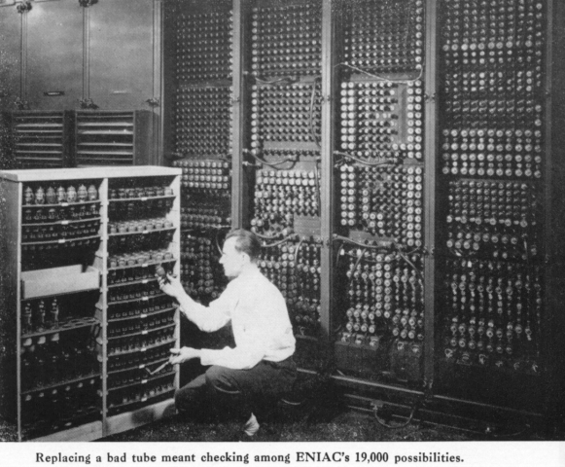
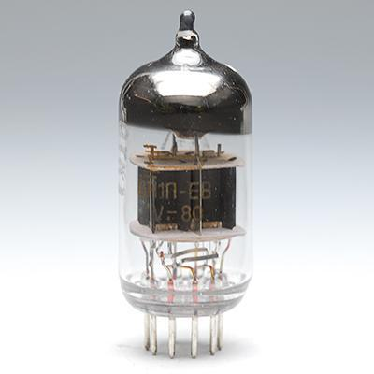
Introduction
Vacuum Tubes

Slide 3
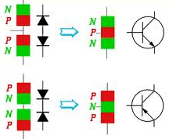
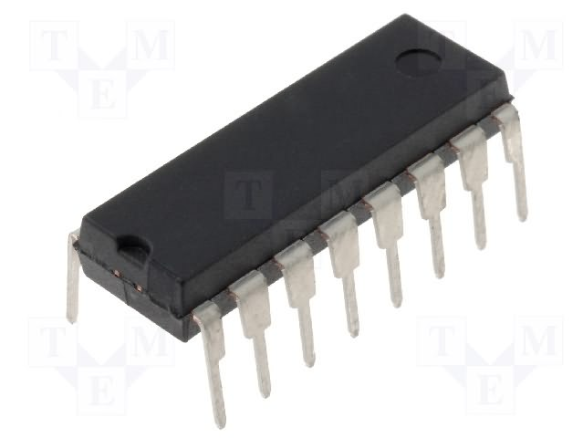
Introduction
Transistor
Integrated Circuits (IC)

Slide 4
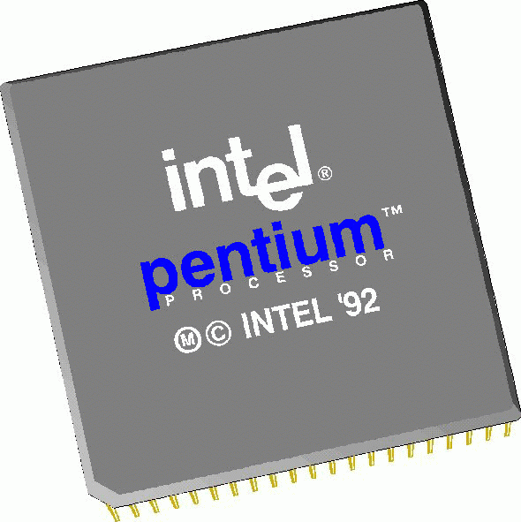
Introduction
Microprocessor
Computers

Slide 5
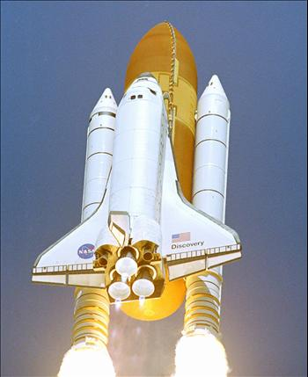
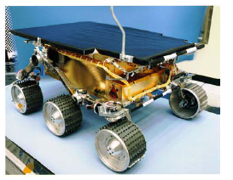
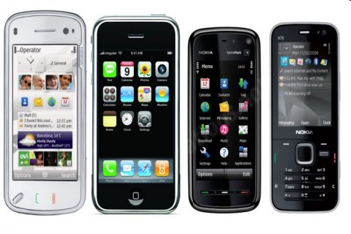
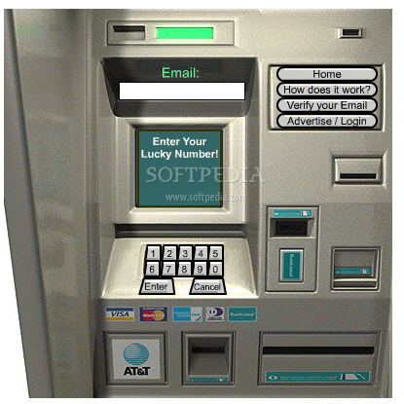
Digital Electronics ……….Everywhere

Slide 6
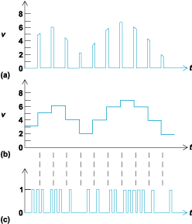
Analog and Digital Signal
X(t)
Sampled
Quantized
Digital
t
Analog signal
Analog signals vary continuously over a specified range with infinite values.
Digital signals can assume only finite values.

Slide 7
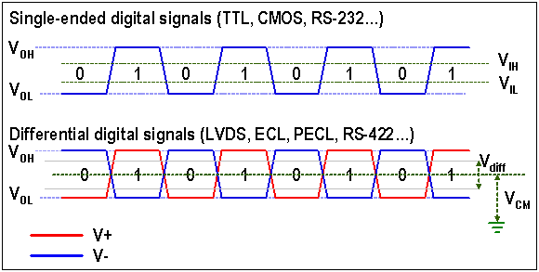
Binary Digital Signal
Digital signals take finite values
Binary logic (2 values: switch on , switch off)
Tri-Logic ( 3 values: traffic signal green, red, yellow)
Quad Logic (4 values: right , left , up, down)
Two level, or binary values are the most prevalent values.

Slide 8
Binary Digital Signal
Binary values are represented abstractly by:
Digits 0 and 1
Words (symbols) False (F) and True (T)
Words (symbols) Low (L) and High (H)
And words On and Off
Binary values are represented by values or ranges of values of physical quantities.
V(t)
Logic 1
undefined
Logic 0
t
Binary digital signal

Slide 9
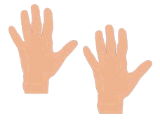
Decimal Number System
Base (also called radix) = 10
10 digits { 0, 1, 2, 3, 4, 5, 6, 7, 8, 9 }
Digit Position
Integer & fraction
Digit Weight
Weight = (Base) ^{Position}
Magnitude
Sum of “Digit x Weight”
Formal Notation
2
1
0
-1
-2
5
1
2
7
4
100
10
1
0.1
0.01
500
10
2
0.7
0.04
d₂*B²+d₁*B¹+d₀*B⁰+d₋₁*B⁻¹+d₋₂*B⁻²
(512.74)₁₀

Slide 10
Binary Number System
Base = 2
2 digits { 0, 1 }, called binary digits or “bits”
Weights
Weight = (Base) ^{Position}
Magnitude
Sum of “Bit x Weight”
Formal Notation
Groups of bits
1 binary digit = bit
4bits = Nibble
8 bits = Byte
4
2
1
1/2
1/4
1
0
1
0
1
2
1
0
-1
-2
1 *2²+0 *2¹+1 *2⁰+0 *2⁻¹+1 *2⁻²
=(5.25)₁₀
1 0 1 1
(101.01)₂
1 1 0 0 0 1 0 1

Slide 11
Octal Number System
Base = 8
8 digits { 0, 1, 2, 3, 4, 5, 6, 7 }
Weights
Weight = (Base) ^{Position}
Magnitude
Sum of “Digit x Weight”
Formal Notation
64
8
1
1/8
1/64
5
1
2
7
4
2
1
0
-1
-2
5 *8²+1 *8¹+2 *8⁰+7 *8⁻¹+4 *8⁻²
=(330.9375)₁₀
(512.74)₈

Slide 12
Hexadecimal Number System
Base = 16
16 digits { 0, 1, 2, 3, 4, 5, 6, 7, 8, 9, A, B, C, D, E, F } Where : A=10, B=11, C=12, D=13, E=14, F=15
Weights
Weight = (Base) ^{Position}
Magnitude
Sum of “Digit x Weight”
Formal Notation
256
16
1
1/16
1/256
1
E
5
7
A
2
1
0
-1
-2
1 *16²+14 *16¹+5 *16⁰+7 *16⁻¹+10 *16⁻²
=(485.4765625)₁₀
(1E5.7A)₁₆

Slide 13
The Power of 2
n | 2^{n}
0 | 2⁰=1
1 | 2¹=2
2 | 2²=4
3 | 2³=8
4 | 2⁴=16
5 | 2⁵=32
6 | 2⁶=64
7 | 2⁷=128
n | 2^{n}
8 | 2⁸=256
9 | 2⁹=512
10 | 2¹⁰=1024
11 | 2¹¹=2048
12 | 2¹²=4096
20 | 2²⁰=1M
30 | 2³⁰=1G
40 | 2⁴⁰=1T
Kilo
Mega
Giga
Tera

Slide 14
Number Base Conversions
Evaluate Magnitude
Octal
(Base 8)
Evaluate Magnitude
Decimal
(Base 10)
Binary
(Base 2)
Hexadecimal
(Base 16)
Evaluate Magnitude

Slide 15
Decimal, Binary, Octal and Hexadecimal
Decimal | Binary | Octal | Hex
00 | 0000 | 00 | 0
01 | 0001 | 01 | 1
02 | 0010 | 02 | 2
03 | 0011 | 03 | 3
04 | 0100 | 04 | 4
05 | 0101 | 05 | 5
06 | 0110 | 06 | 6
07 | 0111 | 07 | 7
08 | 1000 | 10 | 8
09 | 1001 | 11 | 9
10 | 1010 | 12 | A
11 | 1011 | 13 | B
12 | 1100 | 14 | C
13 | 1101 | 15 | D
14 | 1110 | 16 | E
15 | 1111 | 17 | F
15

Slide 16
Decimal (Integer) to Binary Conversion
Divide the number by the ‘Base’ (=2)
Take the remainder (either 0 or 1) as a coefficient
Take the quotient and repeat the division
Example: (13)₁₀
Quotient
Remainder
Coefficient
13
/ 2 = 6
1 a₀ = 1
6
/ 2 = 3
0 a₁ = 0
3
/ 2 = 1
1 a₂ = 1
1
/ 2 = 0
1 a₃ = 1
Answer: (13)₁₀ = (a₃ a₂ a₁ a₀)₂ = (1101)₂
MSB LSB

Slide 17
Decimal (Fraction) to Binary Conversion
Multiply the number by the ‘Base’ (=2)
Take the integer (either 0 or 1) as a coefficient
Take the resultant fraction and repeat the division
Example: (0.625)₁₀
Integer
Fraction
Coefficient
0.625
* 2 = 1 . 25
a₋₁ = 1
0.25
* 2 = 0 . 5 a₋₂ = 0
0.5
* 2 = 1 . 0 a₋₃ = 1
Answer: (0.625)₁₀ = (0.a₋₁ a₋₂ a₋₃)₂ = (0.101)₂
MSB LSB

Slide 18
Decimal to Octal Conversion
Example: (175)₁₀
Quotient
Remainder
Coefficient
175
/ 8 = 21
7 a₀ = 7
21
/ 8 = 2
5 a₁ = 5
2
/ 8 = 0
2 a₂ = 2
Answer: (175)₁₀ = (a₂ a₁ a₀)₈ = (257)₈
Example: (0.3125)₁₀
Integer
Fraction
Coefficient
0.3125
* 8 = 2 . 5
a₋₁ = 2
0.5
* 8 = 4 . 0 a₋₂ = 4
Answer: (0.3125)₁₀ = (0.a₋₁ a₋₂ a₋₃)₈ = (0.24)₈

Slide 19
Binary − Octal Conversion
8 = 2³
Each group of 3 bits represents an octal digit
Octal | Binary
0 | 0 0 0
1 | 0 0 1
2 | 0 1 0
3 | 0 1 1
4 | 1 0 0
5 | 1 0 1
6 | 1 1 0
7 | 1 1 1
Example:
Assume Zeros
( 1 0 1 1 0 . 0 1 )₂
( 2 6 . 2 )₈
Works both ways (Binary to Octal & Octal to Binary)

Slide 20
Binary − Hexadecimal Conversion
16 = 2⁴
Each group of 4 bits represents a hexadecimal digit
Hex | Binary
0 | 0 0 0 0
1 | 0 0 0 1
2 | 0 0 1 0
3 | 0 0 1 1
4 | 0 1 0 0
5 | 0 1 0 1
6 | 0 1 1 0
7 | 0 1 1 1
8 | 1 0 0 0
9 | 1 0 0 1
A | 1 0 1 0
B | 1 0 1 1
C | 1 1 0 0
D | 1 1 0 1
E | 1 1 1 0
F | 1 1 1 1
Example:
Assume Zeros
( 1 0 1 1 0 . 0 1 )₂
( 1 6 . 4 )₁₆
Works both ways (Binary to Hex & Hex to Binary)

Slide 21
Octal − Hexadecimal Conversion
Convert to Binary as an intermediate step
Example:
( 2 6 . 2 )₈
Assume Zeros
Assume Zeros
( 0 1 0 1 1 0 . 0 1 0 )₂
( 1 6 . 4 )₁₆
Works both ways (Octal to Hex & Hex to Octal)

Slide 22
Binary Addition
Column Addition
carry bit
1
1
1
1
1
1
1
1
1
1
0
1
= 61
= 23
+
1
0
1
1
1
1
0
1
0
1
0
0
= 84
= (10)₂

Slide 23
Binary Subtraction
Borrow a “Base” when needed
1
2
= (10)₂
0
2
2
0
0
2
1
0
0
1
1
0
1
= 77
= 23
−
1
0
1
1
1
0
1
1
0
1
1
0
= 54

Slide 24
Binary Multiplication
Bit by bit
1
0
1
1
1
x
1
0
1
0
0
0
0
0
0
1
0
1
1
1
0
0
0
0
0
1
0
1
1
1
1
1
1
0
0
1
1
0

Slide 25
Complements
Diminished Radix Complement - (r-1)’s Complement
Given a number N in base r having n digits, the (r–1)’s complement of N is defined as:
(r^{n} –1) – N
Example for 6-digit decimal numbers:
9’s complement is (r^{n} – 1)–N = (10⁶–1)–N = 999999–N
9’s complement of 546700 is 999999–546700 = 453299
Example for 7-digit binary numbers:
1’s complement is (r^{n} – 1) – N = (2⁷–1)–N = 1111111–N
1’s complement of 1011000 is 1111111–1011000 = 0100111

Slide 26
Complements
1’s Complement (Diminished Radix Complement)
All ‘0’s become ‘1’s
All ‘1’s become ‘0’s
Example (10110000)₂
⇨ (01001111)₂
If you add a number and its 1’s complement …
1 0 1 1 0 0 0 0
+ 0 1 0 0 1 1 1 1
1 1 1 1 1 1 1 1

Slide 27
Complements
Radix Complement
Example: Base-10
Example: Base-2
The r's complement of an n-digit number N in base r is defined as
r^{n} – N for N ≠ 0 and as 0 for N = 0. Comparing with the (r − 1) 's complement, we note that the r's complement is obtained by adding 1 to the (r − 1) 's complement, since r^{n} – N = [(r^{n} − 1) – N] + 1.
The 10's complement of 012398 is 987602
The 10's complement of 246700 is 753300
The 2's complement of 1101100 is 0010100
The 2's complement of 0110111 is 1001001

Slide 28
Complements
2’s Complement (Radix Complement)
Take 1’s complement then add 1 or,
Toggle all bits to the left of the first ‘1’ from the right
Example:
Number:
1’s Comp.:
1 0 1 1 0 0 0 0
0 1 0 0 1 1 1 1
+ 1
1 0 1 1 0 0 0 0
0 1 0 1 0 0 0 0
0
1
0
1
0
0
0
0

Slide 29
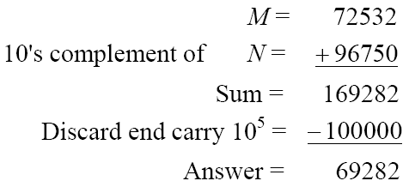
Complements
Subtraction with Complements
Example
Using 10's complement, subtract M-N=72532 – 03250.

Slide 30
Complements
Example
Using 10's complement, subtract M-N= 03250 – 72532.
There is no end carry.
Therefore, the answer is – (10's complement of 30718) = − 69282.

Slide 31
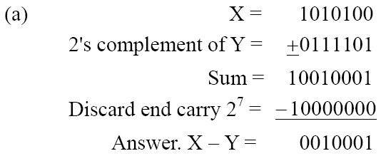
Complements
Example
Given the two binary numbers X = 1010100 and Y = 1000011, perform the subtraction (a) X – Y ; and (b) Y − X, by using 2's complement.
There is no end carry. Therefore, the answer is Y – X = − (2's complement of 1101111) = − 0010001.

Slide 32
Dr. Taoufik Salem Saidani
CPCS214_CPIT210_CPIS210: Computer Architecture
Lecture# 1
Signed Binary Numbers

Slide 33
Signed Binary Numbers
To represent negative integers, we need a notation for negative values (bit placed in the leftmost position).
The convention is to make the sign bit 0 for positive value and 1 for negative value.
Example:

Slide 34
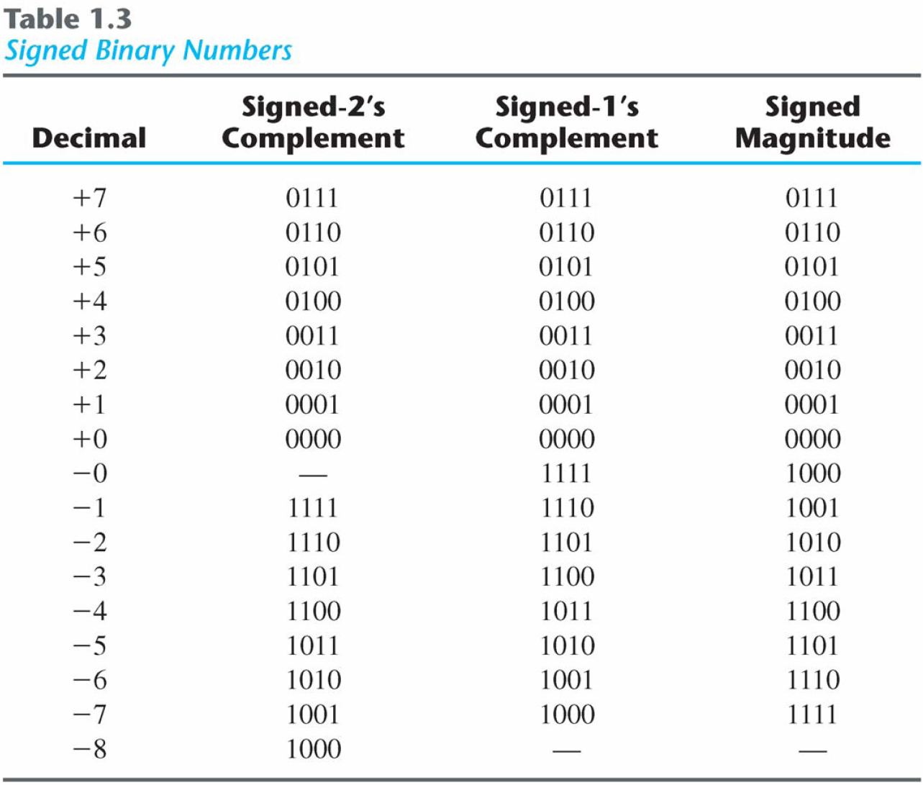
Signed Binary Numbers
Range for signed
n-bit numbers:
- 2^{(n-1)} → + 2 ^{(n-1)} -1

Slide 35
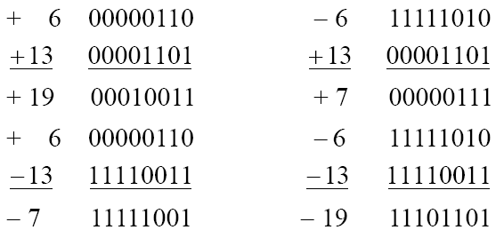
Signed Binary Numbers
Arithmetic addition (using 2’s complement)
Example: n=8 bit code including sign bit (Range -128 → +127)

Slide 36
Signed Binary Numbers
An overflow condition can be detected by observing the carry into the sign bit position and the carry out of the sign bit position. If these two bits are not equal an overflow or underflow is occurred.

Slide 37
Signed Binary Numbers
Comment | Carry out of Sign bit | Carry in of Sign bit
Overflow | 0 | 1
Underflow | 1 | 0
Positive results | 0 | 0
Negative results | 1 | 1

Slide 38
Quiz# 1
Perform the following arithmetic operations using 7-bit signed binary numbers:
+ 51 - 36
+ 23 - 28
ـــــــــ ـــــــــــ

